Slide 1
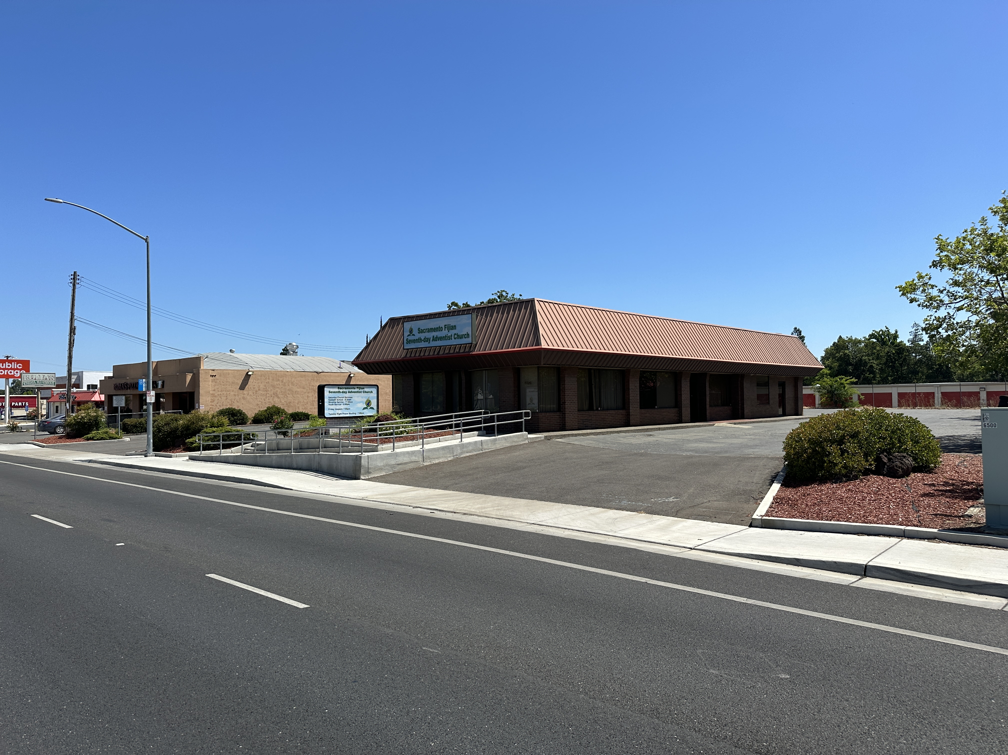
For Sale: Stand-Alone Commercial Building
6526 Fair Oaks Blvd Carmichael, CA 95608

Slide 2
Disclaimer
The contents of the Marketing Brochure provided herein are confidential and proprietary
information. They are intended for the exclusive review of the recipient,
Jahn-Rich, and should not be shared with any other individuals or entities without
written consent from Jahn-Rich. This Marketing Brochure aims to offer a brief overview
of unverified information to potential buyers, serving as an initial expression
of interest in the property. It is important to note that this information does not
replace a comprehensive due diligence investigation. Jahn-Rich has not conducted
any inquiry or made any warranties or representations regarding the property’s
income, expenses, projected financial performance, size, presence of contaminants,
regulatory compliance, physical condition, tenant’s financial situation,
or their plans for occupancy. Although the information in this Marketing Brochure
is sourced from reliable channels, Jahn-Rich has neither verified nor investigated
these matters and does not provide any guarantee or representation
concerning the accuracy or completeness of the information presented.
Prospective buyers must undertake appropriate measures to verify all the
information provided. Jahn-Rich is not affiliated with, sponsored by, or endorsed by any commercial
tenant or lessee mentioned in this marketing package. The inclusion
of any corporation’s logo or name does not imply any affiliation, sponsorship,
or endorsement by said corporation of Jahn-Rich, its affiliates or subsidiaries,
or any of its agents, products, services, or commercial listings.
This information is solely included to provide prospective customers
with tenant lessee information about the listing.
We have obtained this information from sources that we consider reliable; however, we do not provide any explicit or implicit representations or warranties regarding the accuracy of the information. Approximations are used for references to square footage or age. The buyer is responsible for verifying the information and assumes all risks associated with potential inaccuracies.

Slide 3
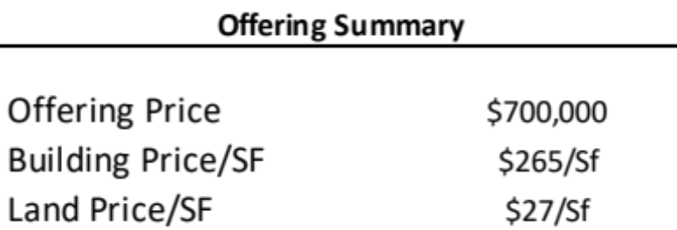
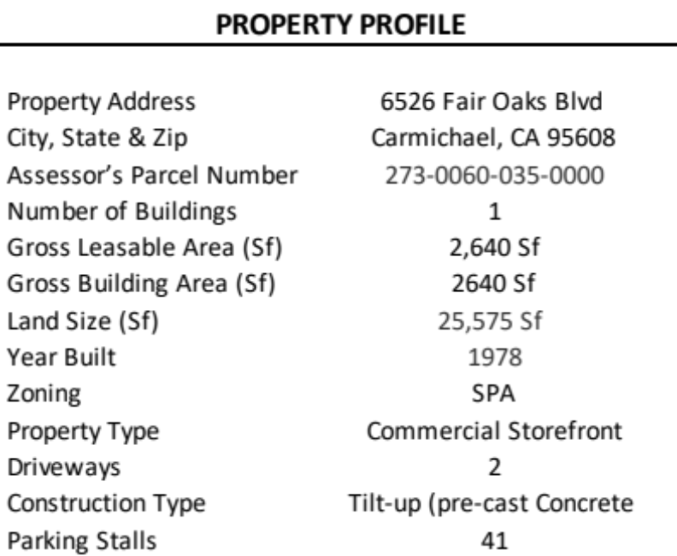
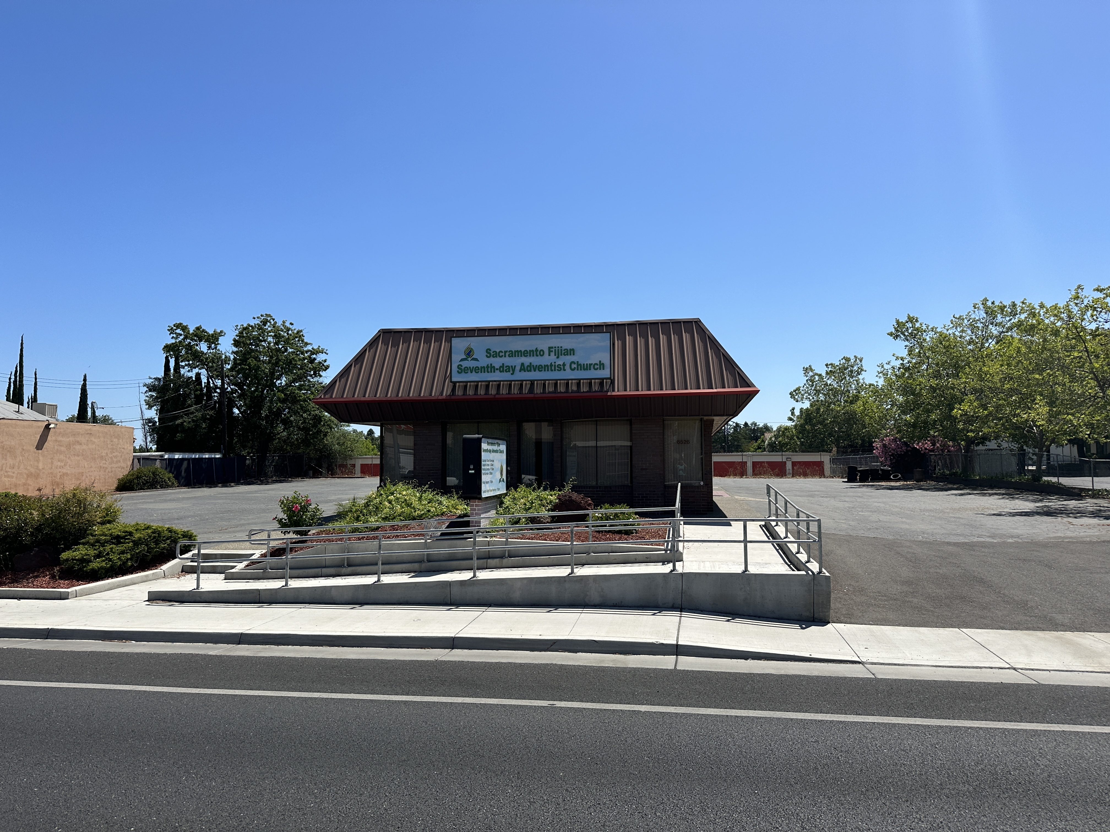
Executive Summary
Property Overview
Jahn-Rich Commercial Real Estate is please to present for sale 6526 Fair Oaks Blvd. The subject property is a stand alone building spanning approximately 0.59 acres with 2,640 square feet of rentable space. With ample parking and two driveways enhancing accessibility, along with its strategic location, high visibility, and drive-thru potential, this property is an enticing option for both owner-users and investors. The current tenant pays $3,000 with a lease that expires 4/25. Positioned centrally in Carmichael, this property caters to those seeking a conveniently located, stand-alone building. Carmichael boasts a strong local economy, a growing population, and established neighborhoods, offering significant potential for growth.
Highlights
Drive-Thru Potential
Positioned along high traffic corridor with great visibility
Features monument sign
Close proximity to dense residential communities and various amenities.

Slide 4
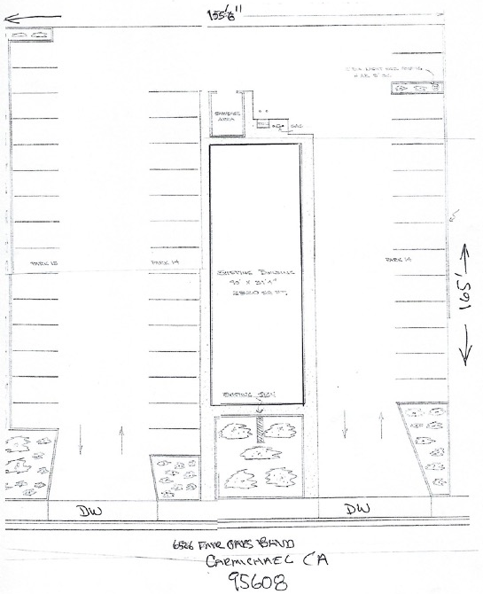
Site Plan

Slide 5
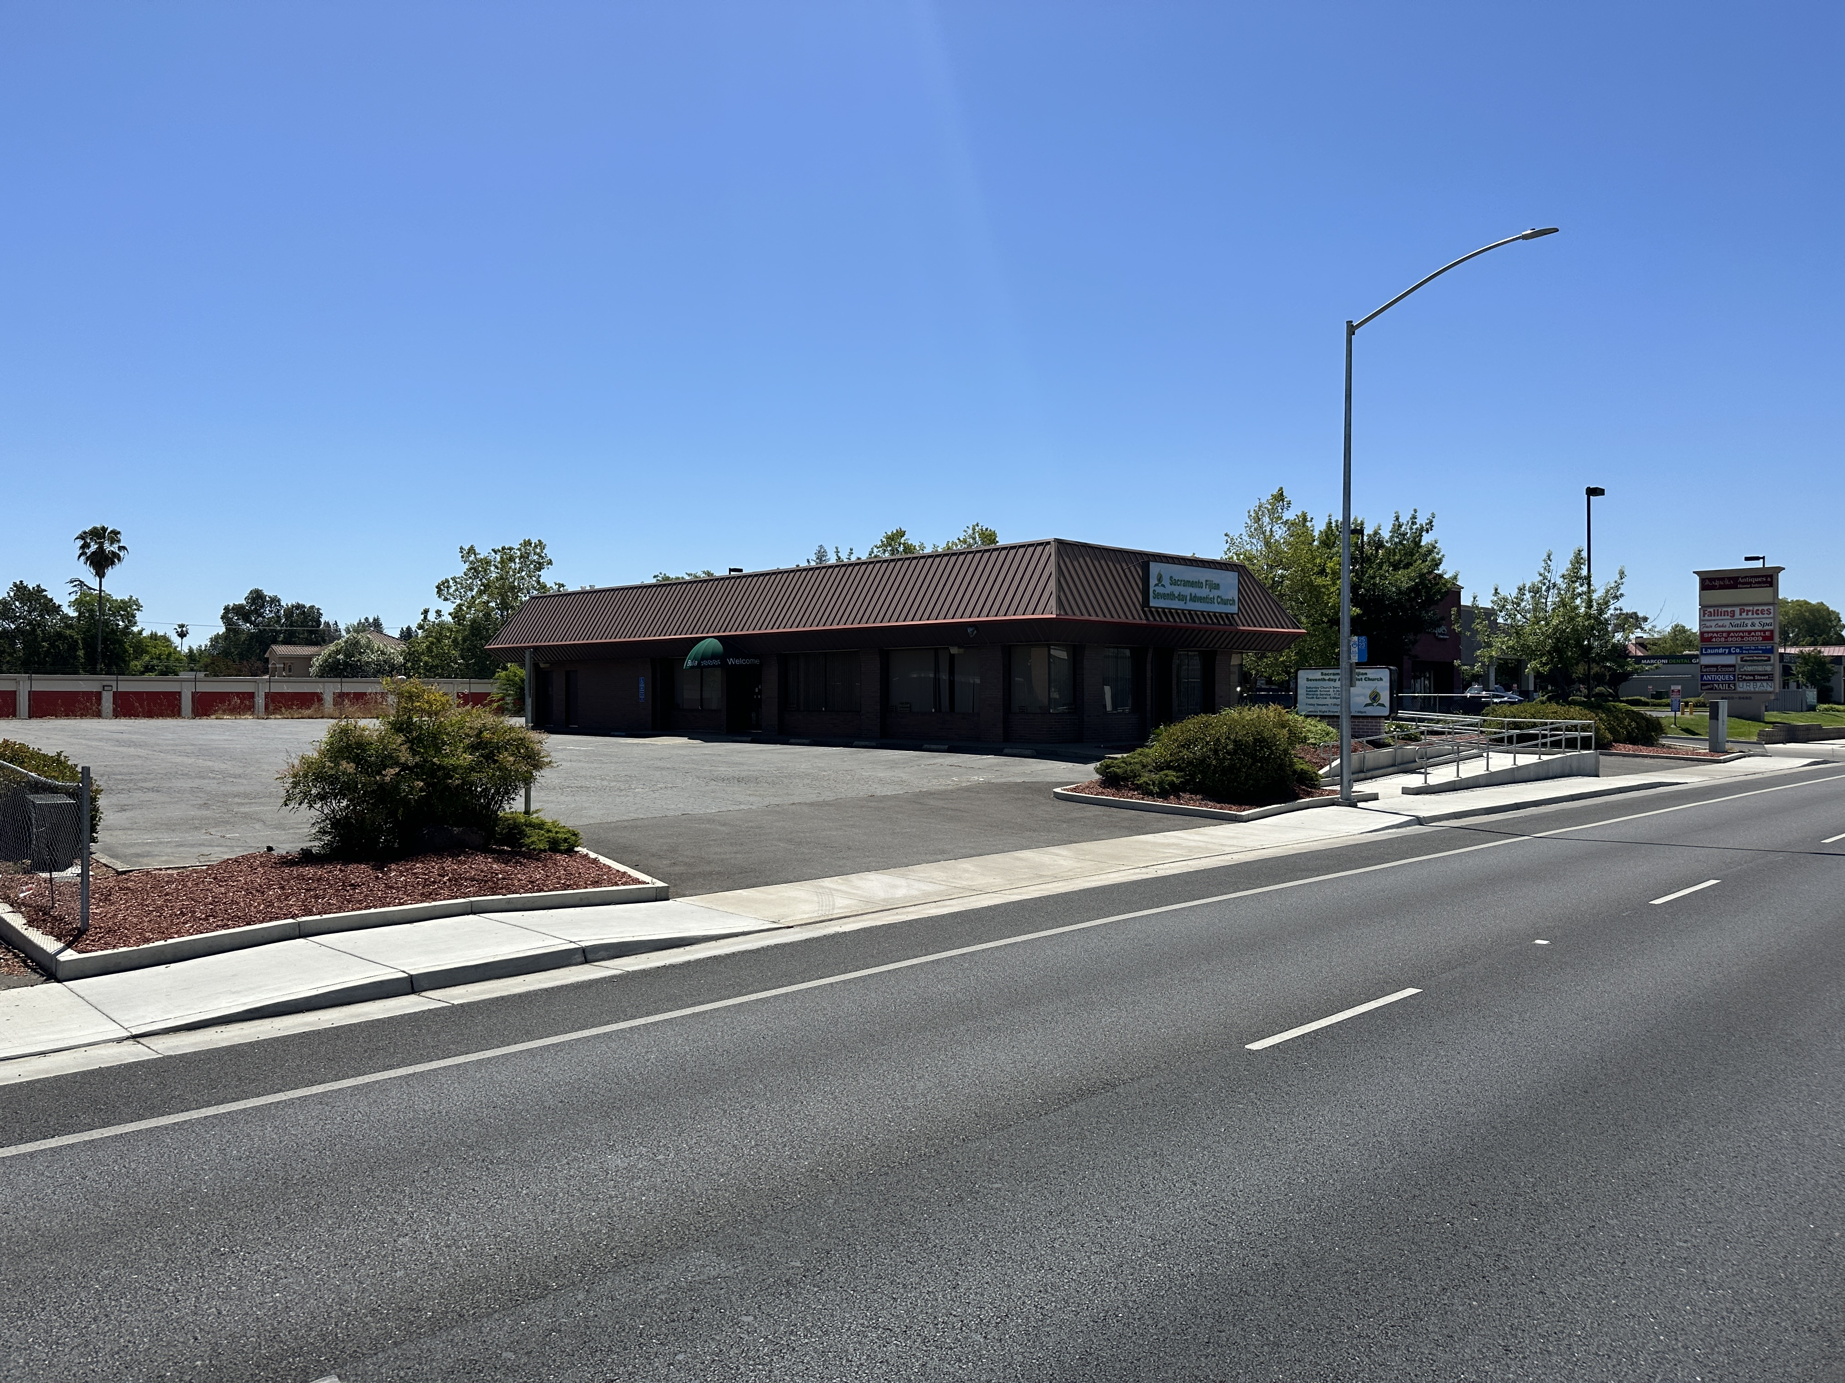
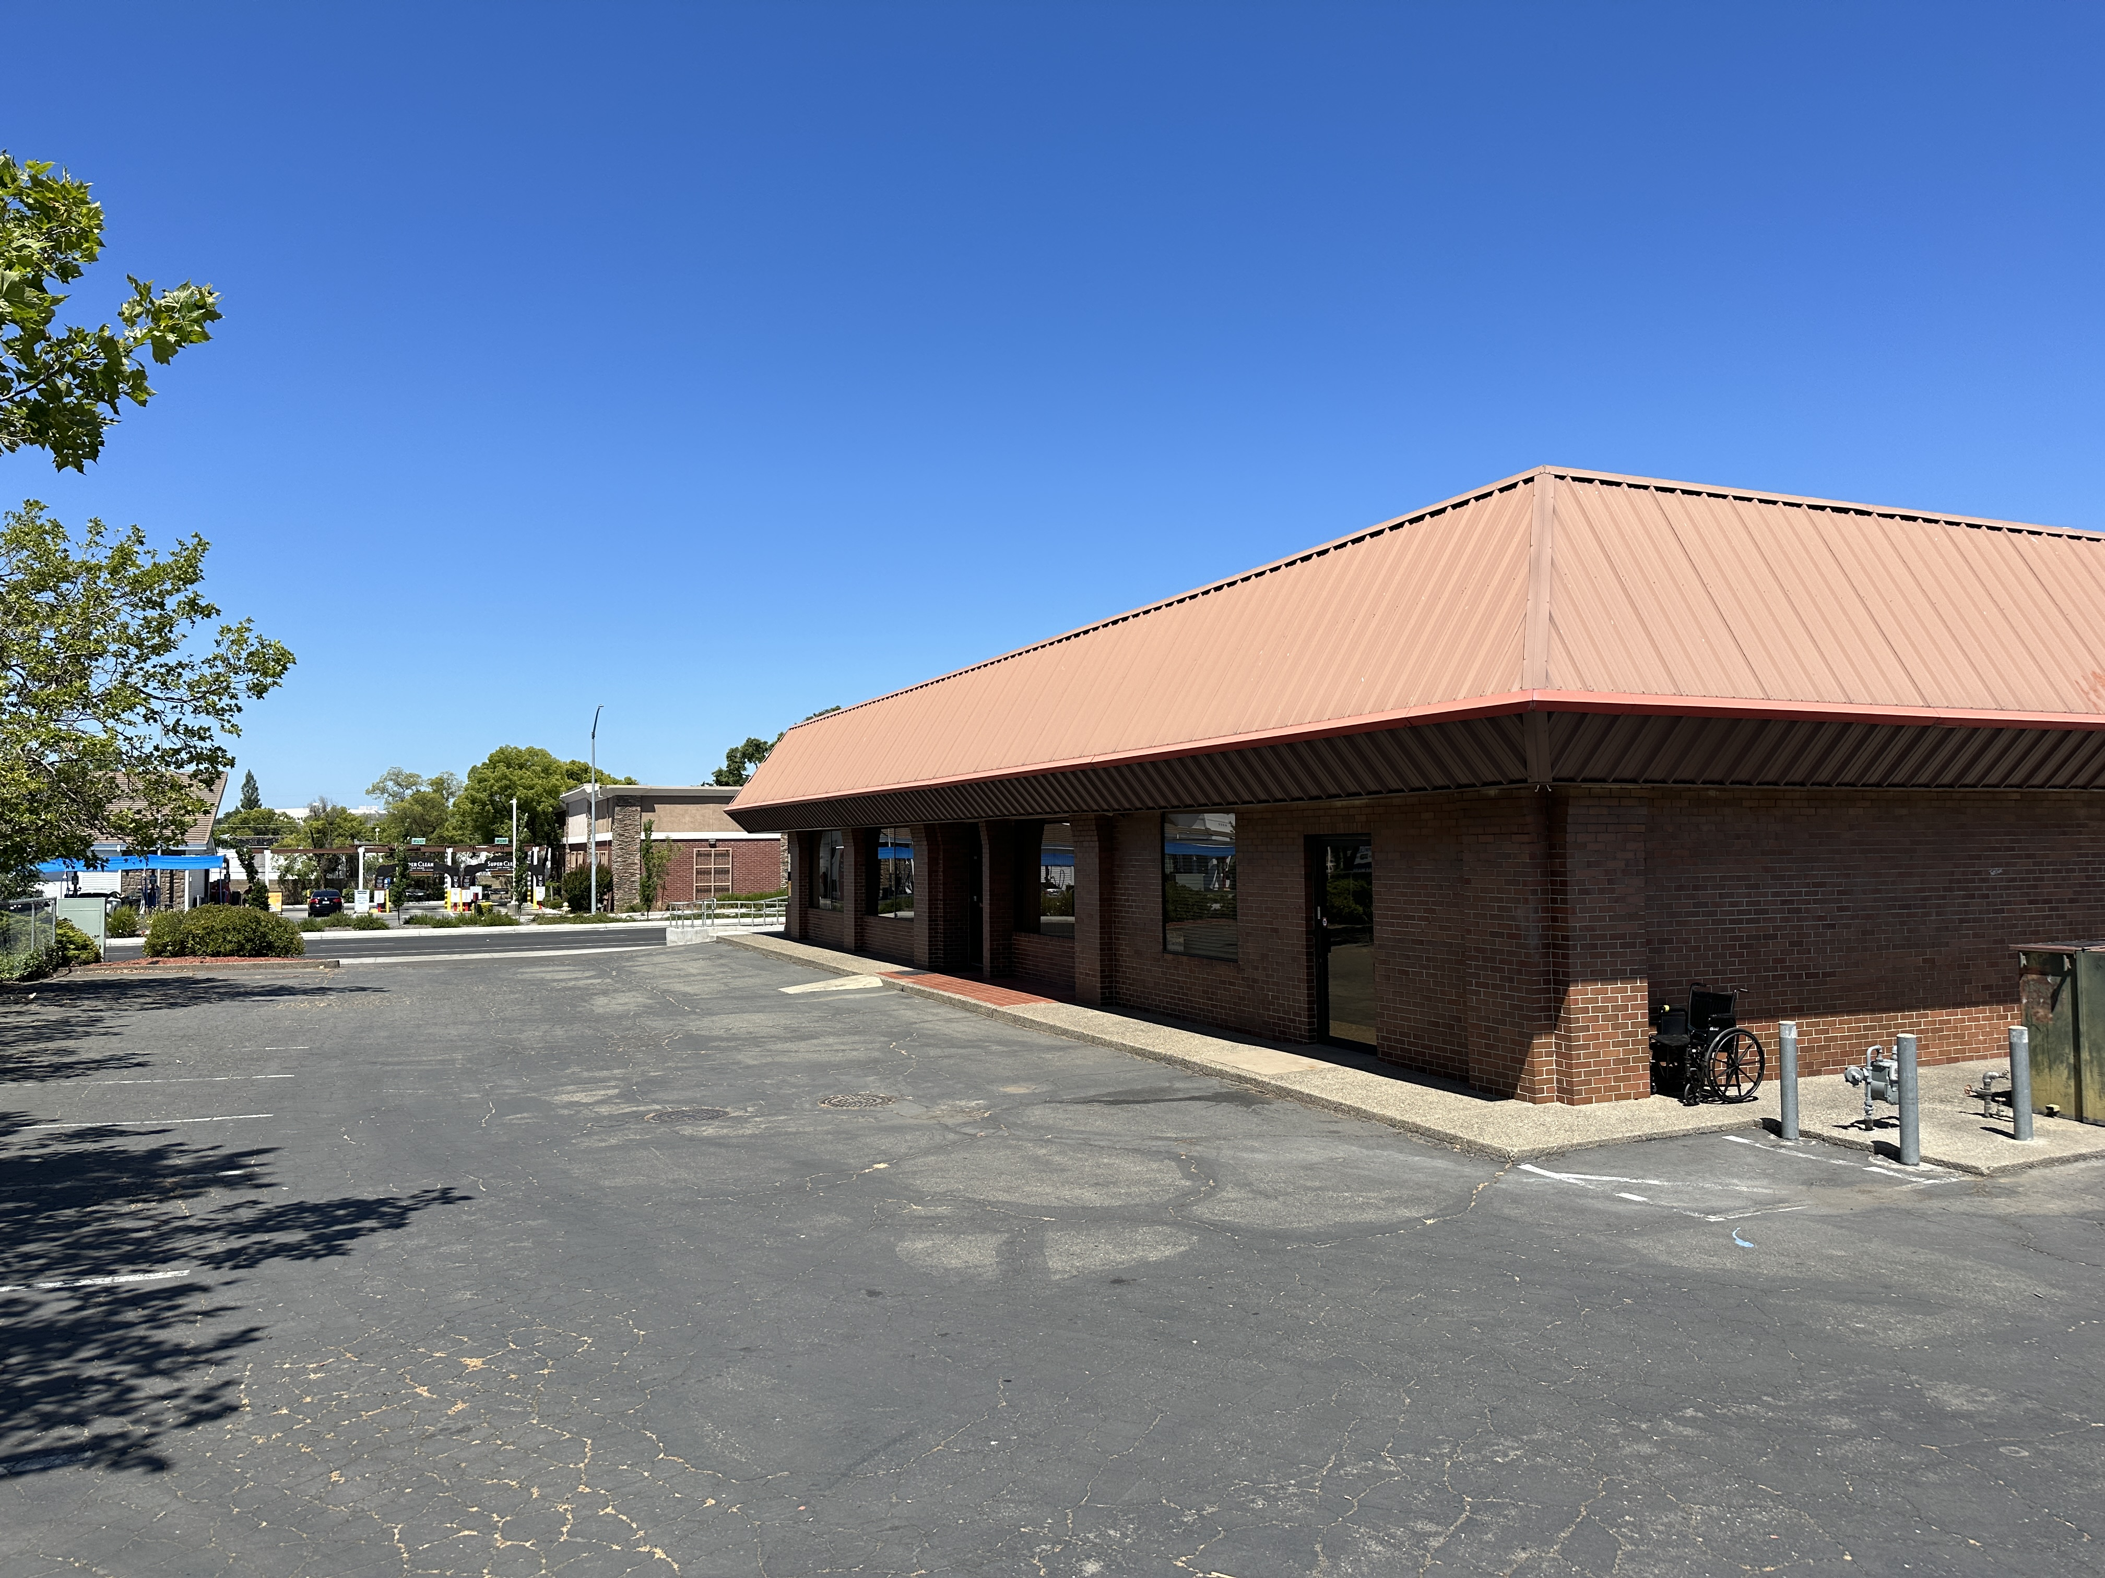
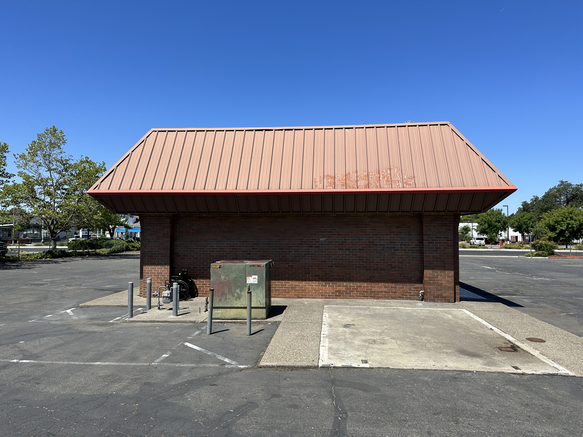
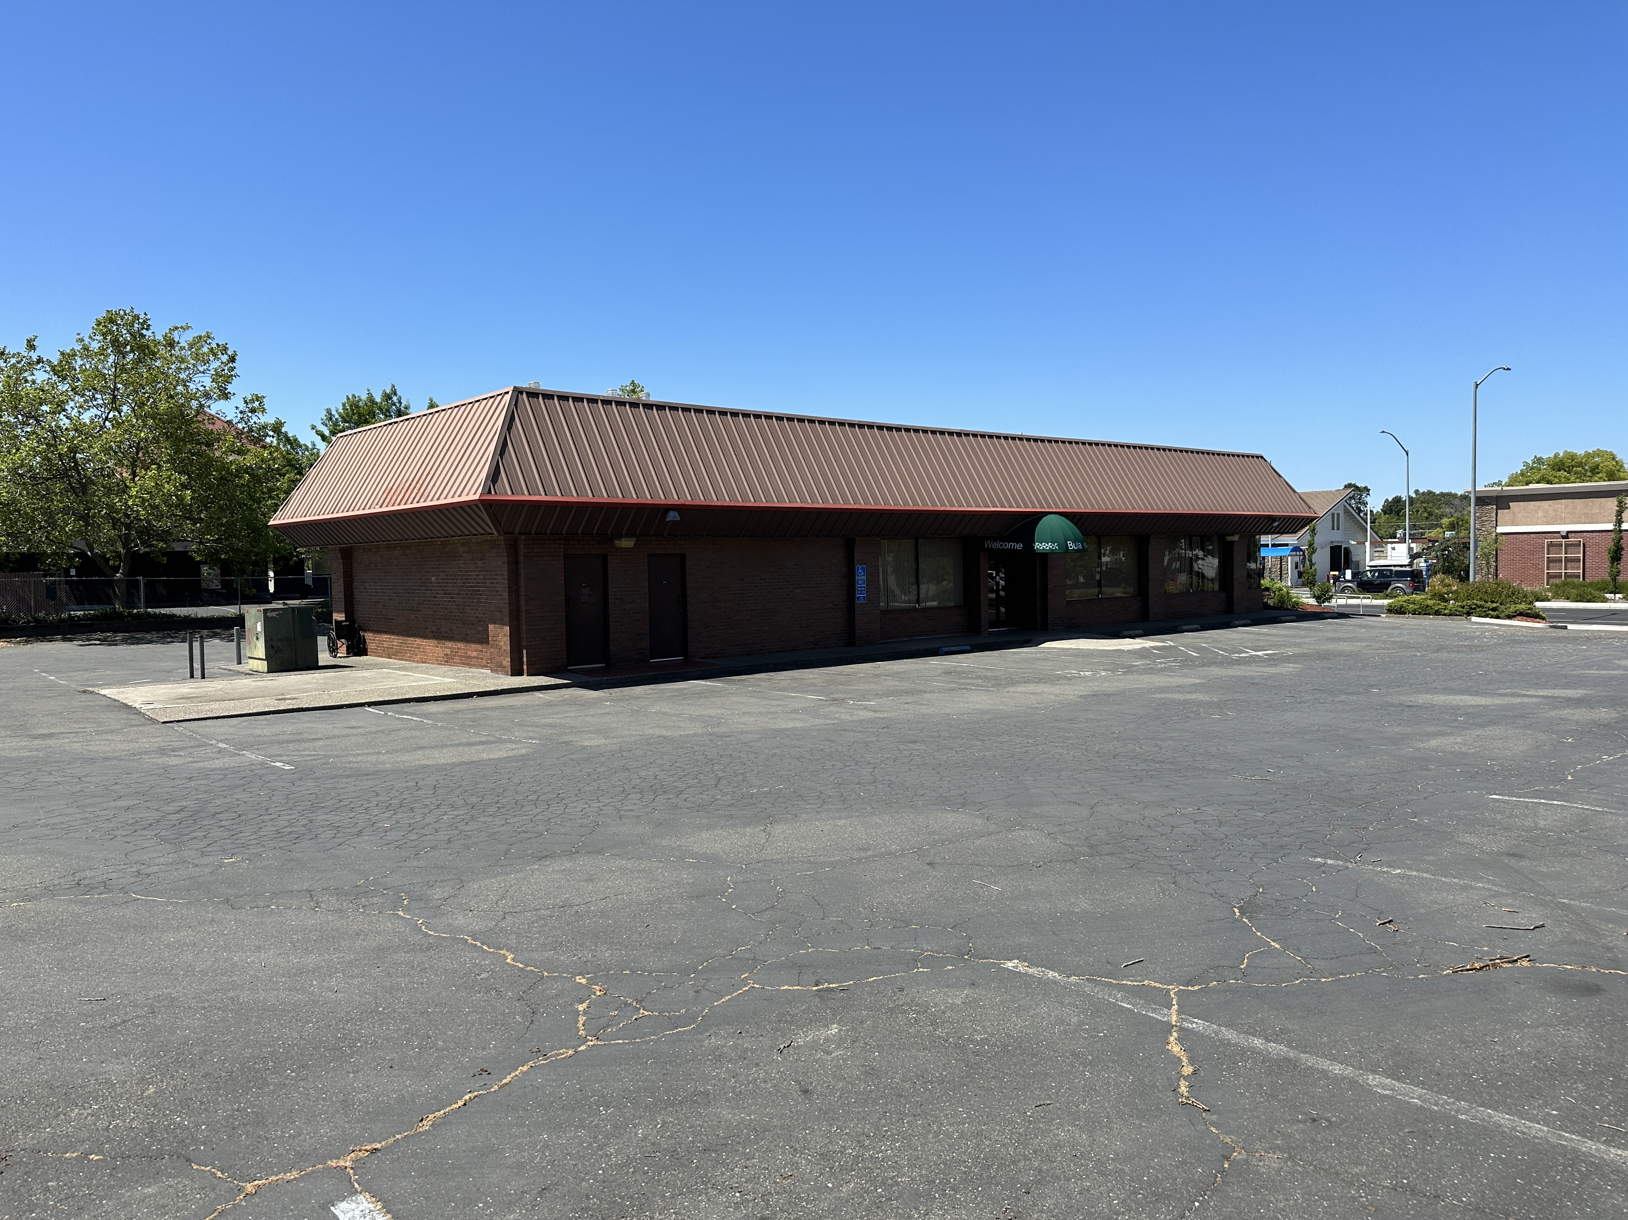
Property Photos

Slide 6
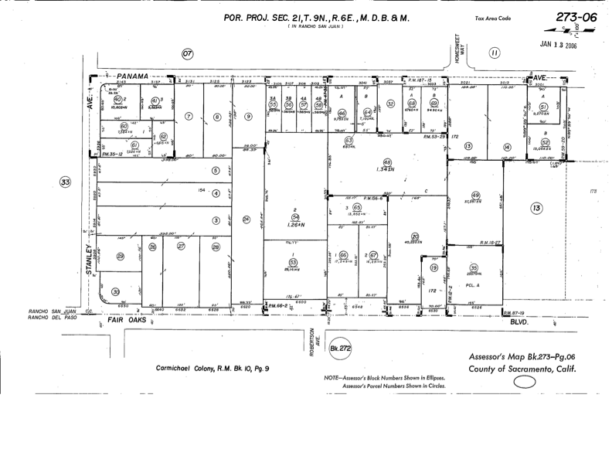
Parcel Map

Slide 7
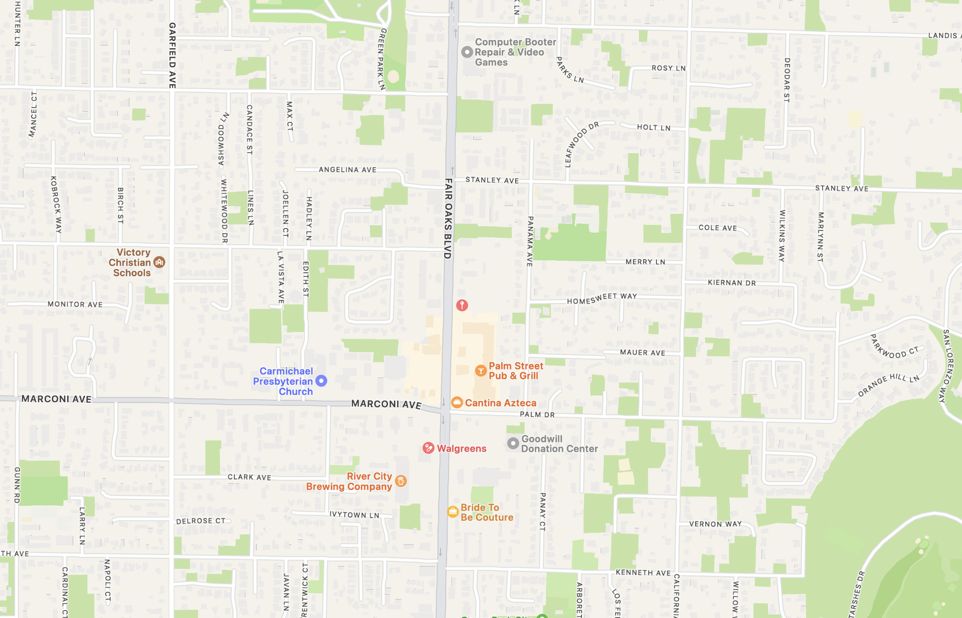
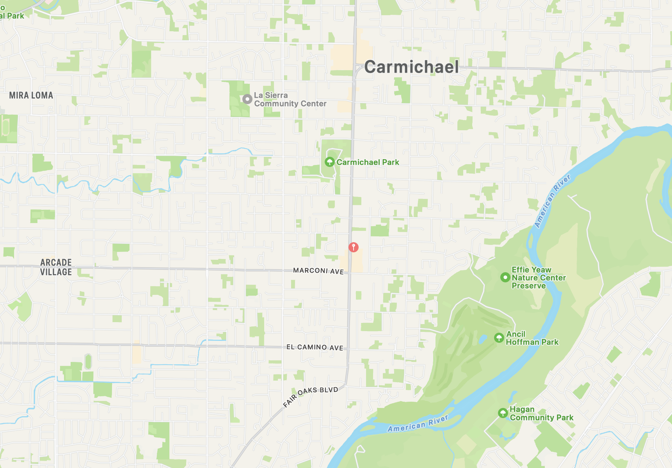
Location Maps

Slide 8
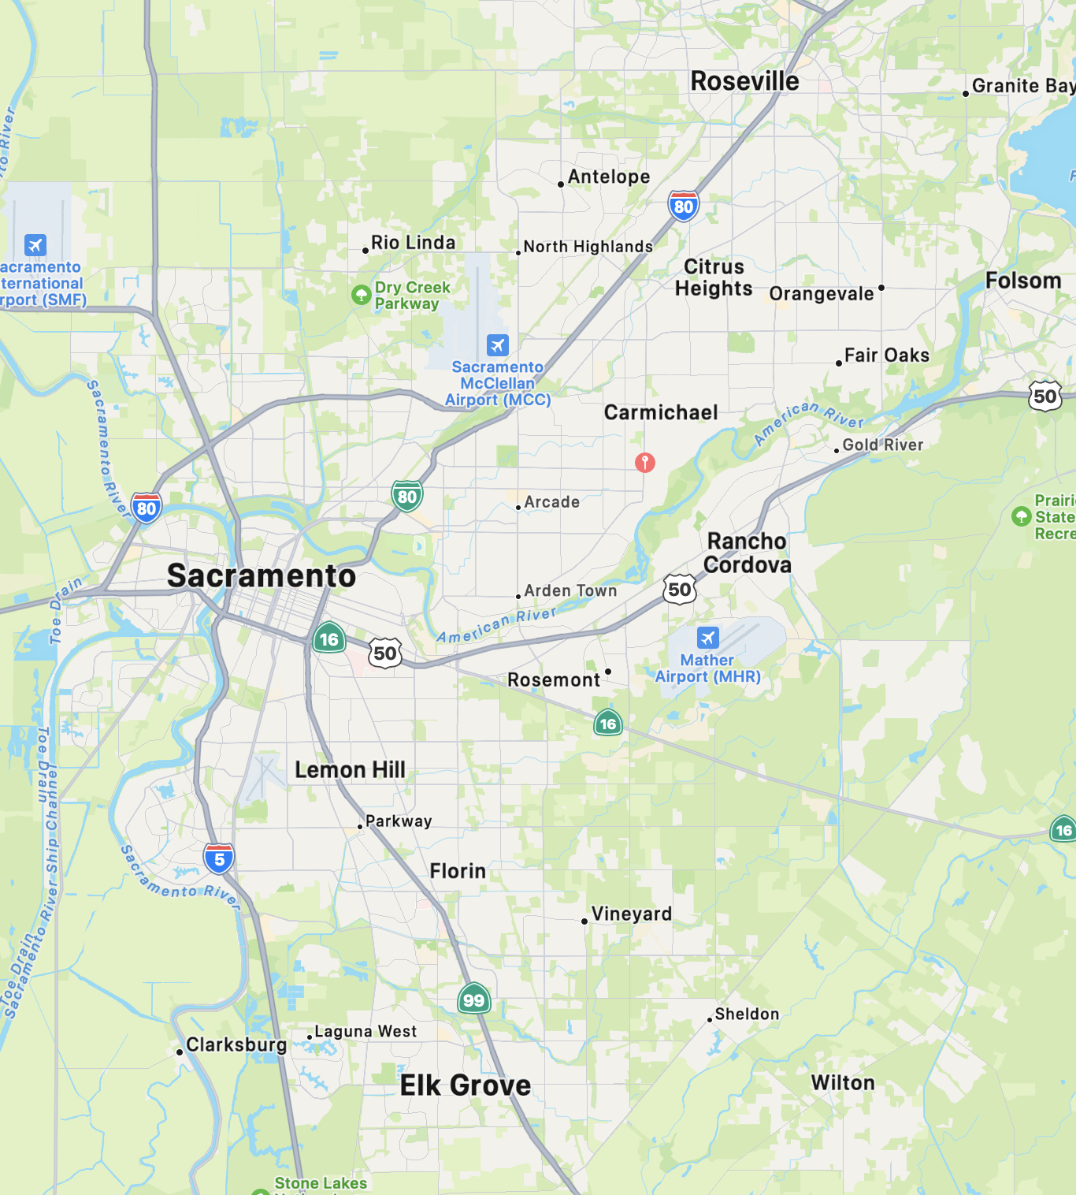
Regional Map

Slide 9
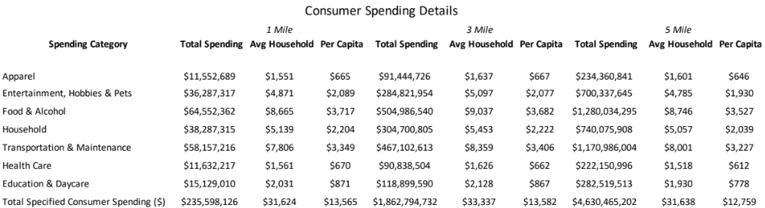
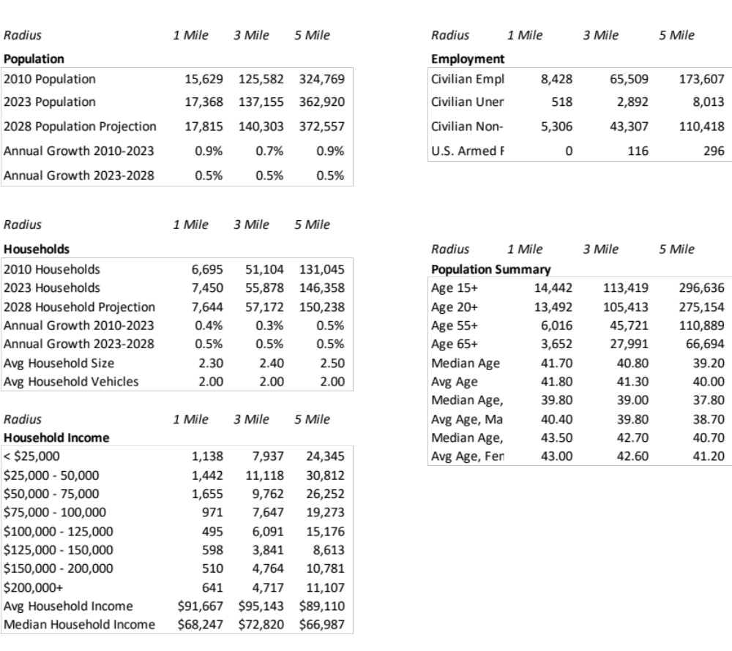
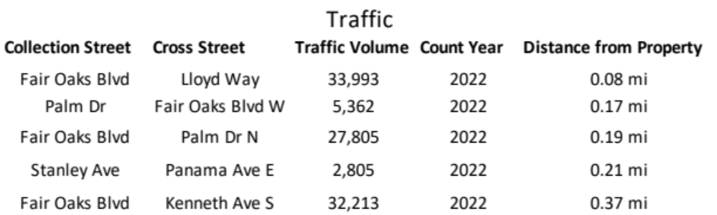
Demographics

